Slide 1
CS250 Computer Architecture
George B. Adams III
Purdue University
Fall 2017

Slide 2
EMERGENCY PREPAREDNESS (part 1)
To report an emergency, call 911. To obtain updates regarding an ongoing emergency, sign up for Purdue Alert text messages, view www.purdue.edu/ea.
There are nearly 300 Emergency Telephones outdoors across campus and in parking garages that connect directly to the PUPD. If you feel threatened or need help, push the button and you will be connected immediately.
Notes:
One final piece of Purdue business before we begin: as we start this semester I want to take a few minutes to discuss emergency preparedness. Purdue University is a very safe campus and there is a low probability that a serious incident will occur here. However, just as we receive a safety briefing each time we get on an aircraft, we want to emphasize our emergency procedures for evacuation and shelter in place incidents. Our preparedness will be critical if an unexpected event occurs.
Purdue prepares for natural disasters or human‑caused incidents with the ultimate goal of maintaining a safe and secure campus, but in the end, emergency preparedness is your personal responsibility. Let’s quickly review the following procedures:

Slide 3
EMERGENCY PREPAREDNESS (part 2)
Fire (loud buzzing alarm and flashing lights)
Evacuate to the outdoors
Use back doors or side door
Do not use an elevator
Notes:
One final piece of Purdue business before we begin: as we start this semester I want to take a few minutes to discuss emergency preparedness. Purdue University is a very safe campus and there is a low probability that a serious incident will occur here. However, just as we receive a safety briefing each time we get on an aircraft, we want to emphasize our emergency procedures for evacuation and shelter in place incidents. Our preparedness will be critical if an unexpected event occurs.
Purdue prepares for natural disasters or human‑caused incidents with the ultimate goal of maintaining a safe and secure campus, but in the end, emergency preparedness is your personal responsibility. Let’s quickly review the following procedures:

Slide 4
EMERGENCY PREPAREDNESS (part 3)
If we are notified during class of a Shelter in Place requirement for a tornado warning, we will suspend class and shelter downstairs if there is time and in this room.
If we are notified during class of a Shelter in Place requirement for a hazardous materials release, or a civil disturbance, including a use of weapons, we will suspend class and shelter in the classroom, shutting the door and turning off the lights.
Please review the Emergency Preparedness website for additional information. http://www.purdue.edu/ehps/emergency_preparedness/index.html
Notes:
One final piece of Purdue business before we begin: as we start this semester I want to take a few minutes to discuss emergency preparedness. Purdue University is a very safe campus and there is a low probability that a serious incident will occur here. However, just as we receive a safety briefing each time we get on an aircraft, we want to emphasize our emergency procedures for evacuation and shelter in place incidents. Our preparedness will be critical if an unexpected event occurs.
Purdue prepares for natural disasters or human‑caused incidents with the ultimate goal of maintaining a safe and secure campus, but in the end, emergency preparedness is your personal responsibility. Let’s quickly review the following procedures:

Slide 5
TWO-WAY PEDESTRIAN SAFETY
We developed pedestrian habits when most campus streets were one way
Danger comes from both directions now
Think twice before you step into a street
Remind yourself to look both ways until it is your new habit
Tell your friends to look both ways
Notes:
Huge changes to campus over the summer.

Slide 6
CS250 General Information
Prof. Adams
My office: HAAS 122
Email: gba@purdue.edu
GTAs
Labs and office hours in LWSN B160
Blackboard will host assignments, solutions, grades, announcements, lecture slides
CS wiki page will host course information
Piazza.com will host online discussion

Slide 7
Grading
Grade allocation
Quizzes (in lectures) 10%
Homework 15%
Labs 40%
Midterm exams (2) 20% (10% each)
Final exam 15%
Lowest lab score, lowest homework score, and two lowest quiz scores will be dropped
Notes:
DECIDE ON PERCENTAGES

Slide 8
Lecture
Lecture content and experience is essential; attendance is strongly recommended
Handwritten note taking recommended
Research shows that handwritten note taking results in better, faster learning
Better for making and annotating diagrams, which are key to describing computer architecture
Bring your iClicker to lecture; for-credit quiz in each subsequent lecture
Notes:
Research shows that handwritten note taking results in better, faster learning

Slide 9
Textbook
Essentials of Computer Architecture – Second Edition (2016), by Douglas Comer ISBN-13: 978-1138626591
We will cover 90+% of its content
Copies on reserve at MATH Library front desk
Reading – key concepts, terminology, examples
Figures and exercises – starting points for exploring computer architecture designs

Slide 10
Homework and Lab Assignments
Purpose is to
Gain experience with applying basic concepts
Develop deductive skills, insights, and intuition
Explore design alternatives
Self-test fluency and facility with course material
Assignments posted on Blackboard
Unlimited uploads of your PDF answers document
Final, timely upload is the one that will be scored
Notes:
Assignments are an excellent component of your exam preparation process.

Slide 11
Lab
Lab attendance is required
Lab projects
Assigned weekly
Provide hands-on experience with digital logic circuits and assembly language programming
Receive lab kit this week and gain familiarity with its contents

Slide 12
Exams
Midterm #1 – Thursday, Sep. 21, 6:30pm
Midterm #2 – Thursday, Oct. 26, 6:30pm
Final Exam – may be as late as Dec. 16
Notes:
Don’t leave for home without it (the final exam)!

Slide 13
Course “equipment”
Textbook
iClicker
Lab kit

Slide 14
Course Resources
Textbook, slides – concepts, topics, definitions
Homework – develop and test understanding
Lab kit – hardware hands-on experience
Lecture – “paint the picture”, examples, Q&A
Blackboard – assignments, announcements, grades
Wiki pages – course information
Piazza – collaborative Q&A
TAs – Q&A in lab and GTA office hours
George Adams – Q&A in office hours

Slide 15
About George Adams
Personal history
BS (VA Tech), MS and PhD (Purdue) in EE
focused on high-performance parallel computing
worked at NASA Ames Research Center and taught at Stanford University part time
Purdue work also in ECE, Birck Nanotechnology Center, Krannert
Current academic activity
CS 240, CS 250, subject matter reading and writing
Enjoys
Science fiction
Collecting computer hardware and paraprosdokians

Slide 16
What to expect of your instructors
The TAs and I welcome you to CS 250
My task, our task, is to support you in your effort to succeed in this course
We welcome your questions: in class, in lab, in office hours, on Piazza, via email
We ask for your feedback throughout the semester
Notes:
Each of you belong here; the TAs and I are happy you are here.
This will be a demanding and reasonable course. I know that each of you can succeed in this course.
Be in touch with us throughout the semester.
What is working, what has failed, what could be better.

Slide 17
What I expect of students
Attendance and being engaged
Integrity and honesty
Notes:
This will be a demanding and yet reasonable course. Do your work with integrity and honesty.
I will not take attendance in lecture, but not attending tends to undermine my support for your success.
That said, I understand the necessity of occasional absence. Let me know; I’m happy to arrange support for arranged absences.

Slide 18
Lecture 01 – Setting the stage
Power on; boot to multiuser
2017.08.21
All photos by George B. Adams III unless otherwise credited.

Slide 19
Assignment for Week 01
Attend your lab session and complete Lab 01
Login to Blackboard and Piazza
Register your iClicker
Read textbook Chapters 1 and 2
Read through course wiki at courses.cs.purdue.edu/cs25000:spring2017:start
Notes:
UPDATE URL

Slide 20
Civilization advances by extending the number
of important operations which we can perform
without thinking about them.
Alfred North Whitehead
An Introduction to Mathematics (1911)
I think it’s fair to say that personal computers have become the most empowering tool we’ve ever created.
Bill Gates
February 24, 2004
Notes:
Where are we today? How did we get where we are today?

Slide 21
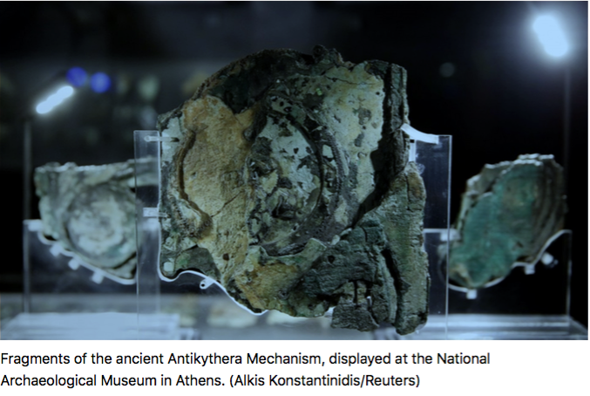
Earliest known mechanical computer, ca 200 BC
At least 30 bronze gears. Counted days for at least three different calendars and the timing of the Olympics. Pointers representing stars and planets revolved around its front face, indicating their position in relation to Earth. A black and white painted model of the moon rotated to model the real moon's waxing and waning.
Notes:
Fixed program and data.

Slide 22
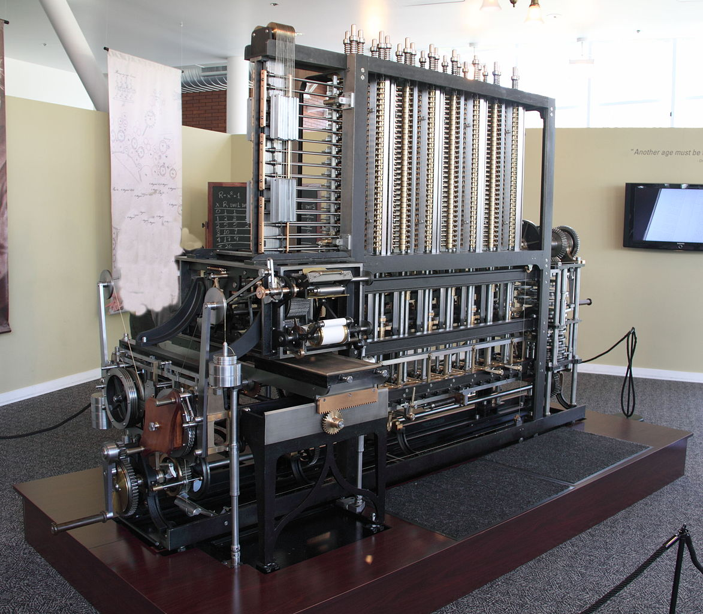
Babbage Difference Engine No. 2
Design completed 1849, 20 years before founding of Purdue University
First complete build 2002
8000 parts
3.5 m long
10,000 kg
Powered by hand crank
Solves 7th order polynomials to 31 decimal digits using the Method of Differences
Includes formatted printer for error-free output
Photo © Canticle at English Wikipedia
https://commons.wikimedia.org/wiki/File:Difference_engine.JPG
Notes:
WHAT DID MYRHVOLD PAY?
Was on display at the Computer History Museum until Jan. 31, 2016, now on display at Intellectual Ventures in Seattle, WA.
Fixed program and variable data.

Slide 23
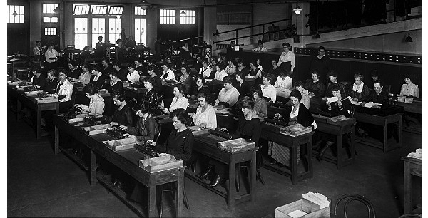
Popular historical computer architecture
A team of Computers (a job title) working on a large calculation.
Common until the late 1940s. Image ca. 1920, US Library of Congress.
Hardware = desktop mechanical adding machines, furniture, and employees
Software = ?
A team of Computers (a job title) working on a large calculation.
Common until the late 1940s. Image ca. 1920, US Library of Congress.
Hardware = ?
Software = ?
A team of Computers (a job title) working on a large calculation.
Common until the late 1940s. Image ca. 1920, US Library of Congress.
Hardware = desktop mechanical adding machines, furniture, and employees
Software = the work procedure: the program is stored in human memory
Notes:
What do you see here?
This is not a case of doing something without having to think about it.
Can you categorize the entities in this photograph that comprise the computing platform hardware? The software?
Variable program and data.

Slide 24
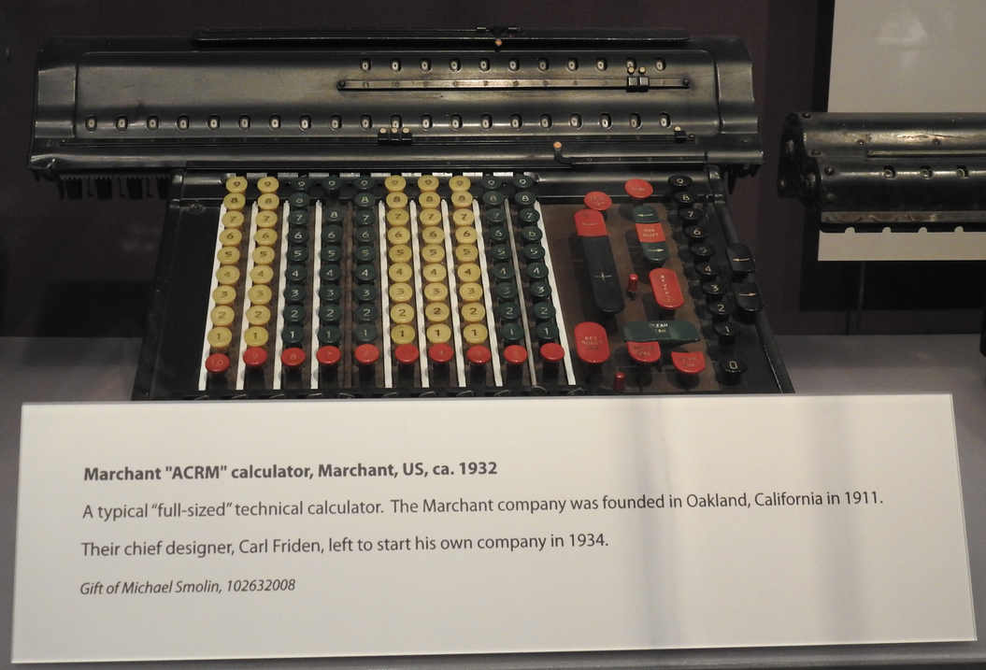
Marchant calculator
Notes:
COST TO ACQUIRE???????
A mechanical computer widely used during the 1920s – 1940s.
It takes seconds to enter the augend and addend, and 1 second to add via
turning of gears. Some were hand-cranked, others had an electric motor.
Image © George Adams. Taken at the Computer History Museum on July 08, 2017.

Slide 25
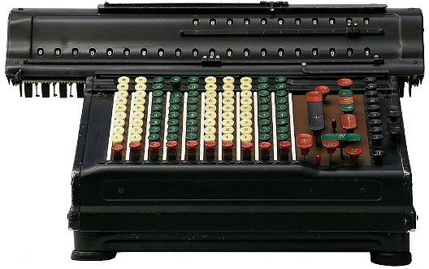
Limitations of computing mechanically
Disadvantages of computation via moving mechanical parts
Volume and mass of parts (big & heavy computer)
Cost to manufacture parts ($$$ computer)
Moving parts wear (degrading functionality)
Moving parts is energy-intensive (hot, $)
Feasible part speeds are subsonic (slow computer)
Need a much better “moving part”

Slide 26
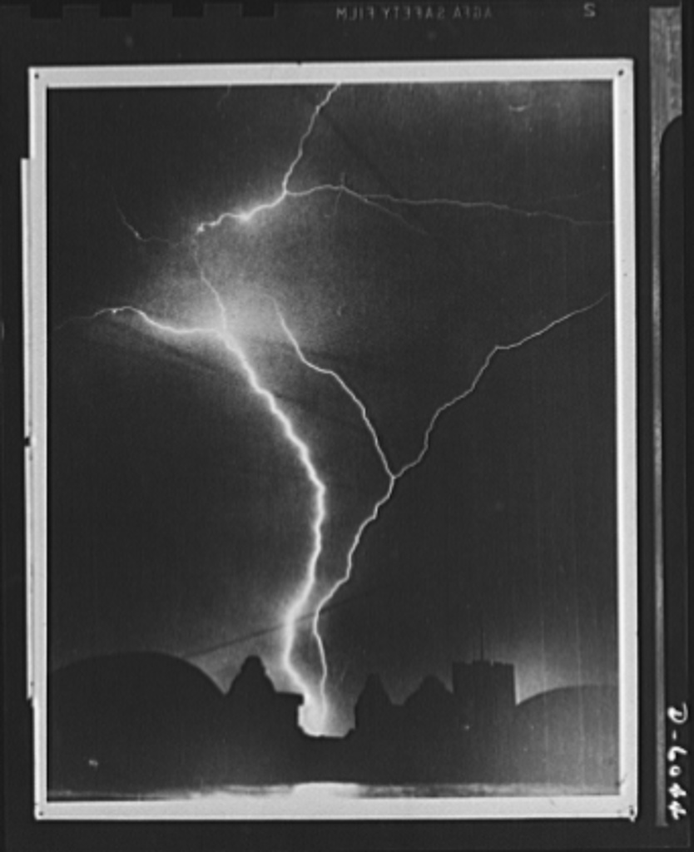
Use electrons as the moving part.
Electron’s charge lets us manipulate them easily with electric fields.
Miniscule volume and mass means a tiny amount of energy sends them through wires and transistors at circa 1/2 the speed of light.
Electronic computers are small, light, fast, and inexpensive.
Lightning is a burst of electrons in motion
Image courtesy Library of Congress
Notes:
REVISE

Slide 27
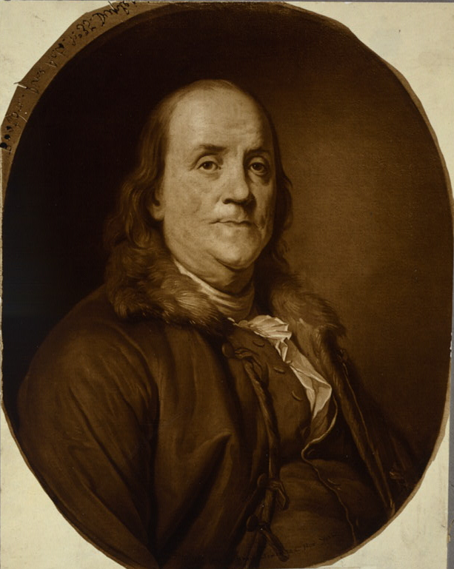
Benjamin Franklin and the electron
When the two electrical charges of the electron and the proton were first recognized, some called the charges Black and Gold.
In 1747
Benjamin Franklin chose the terms we use today: positive and negative
Portrait from Library of Congress

Slide 28
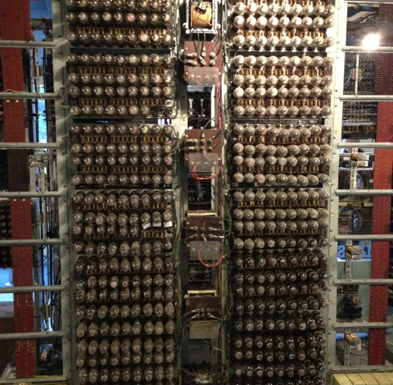
Very early electronic computer
Colossus – built by British cryptographers at Bletchley Park to break the Lorenz cipher
2,500 vacuum tubes, the largest circuit of its time
Notes:
ENDED here LE2

Slide 29
Vacuum tube computer pro and con
Easy 1000-fold speed increase over mechanical with promise of much more
Not much smaller than comparable mechanical
Power intensive
Poor reliability sharply limits circuit complexity, and thus computational capability (Vacuum tubes burn out like incandescent light bulbs)
Bell Telephone seeking to replace vacuum tubes undertakes research in physics of electron behavior in semiconductive crystals

Slide 30
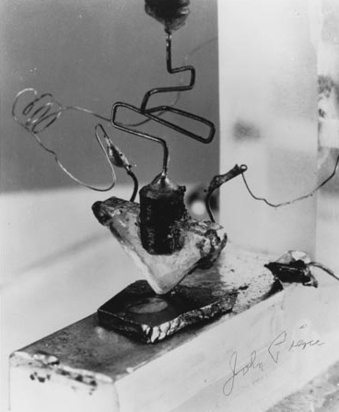
The first transistor, 1947
Built at AT&T Bell Labs
Used a high quality germanium (Ge) crystal made in a Purdue Physics lab in the room now serving as PHYS 201

Slide 31
The first transistor, 1947
Today, humans make ~8x10¹² transistors every second, and that number continues to increase
You could say that Homo sapiens is becoming Homo transistorus
Notes:
Circa 1100 transistors per capita per second
Because 60*60*24 = 86,400 seconds/day and 8x10^12/7x10^9 = 1.14x10^3 transistors per person per second.
Your recommended daily allowance of transistors is 86,400 x 1.14x10^3 = 98,500,000 transistors / day

Slide 32
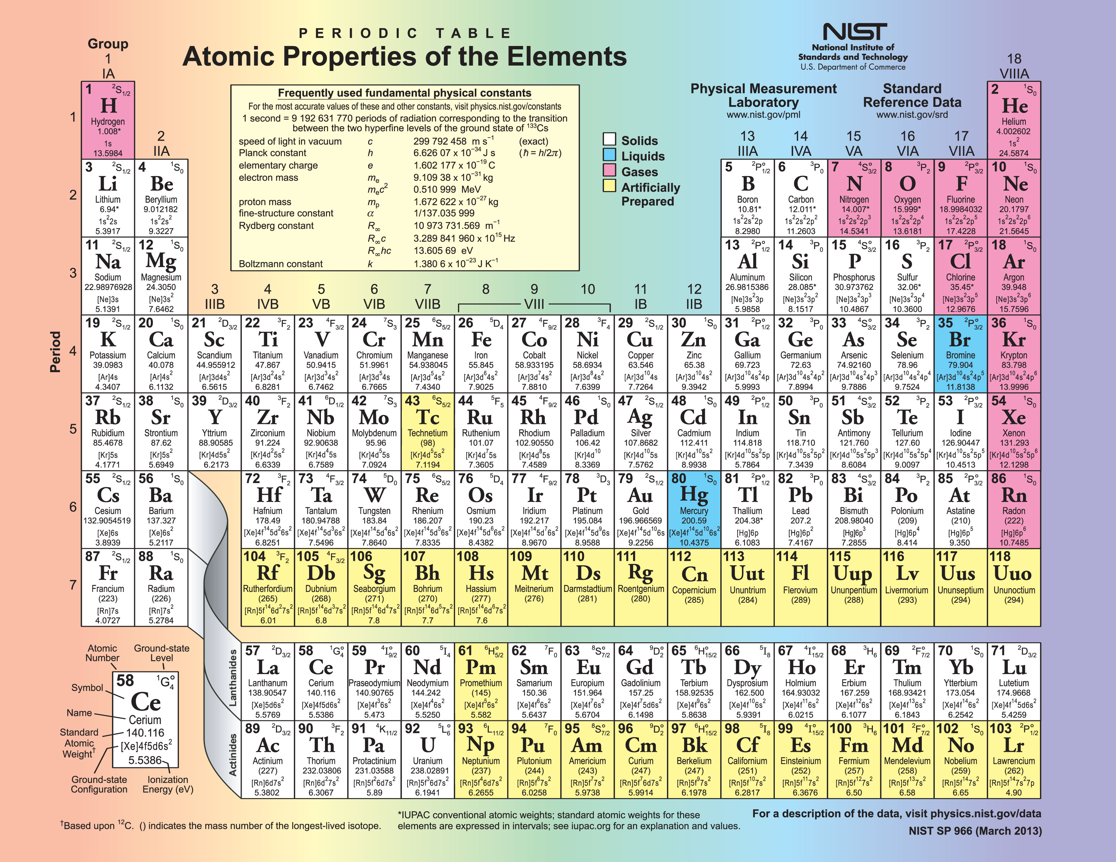
Today’s electronic computing platform is usually built on elemental silicon (Si) crystals. Ge and certain alloys – GaAs, SiN – are also in use. A 2-D form of C, called graphene, may become important soon, as well as a 2-D form of P.

Slide 33
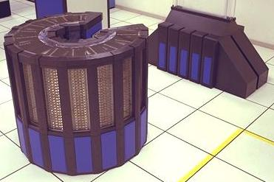
Computing is change – e.g., Hardware
May 1985 NASA Ames Research Center acquires the first full-size Cray-2 “Supercomputer”
Photo courtesy NASA
Notes:
14 columns of logic, memory, and power supplies. 300 degree arc, 45 inches (114 cm) tall, 53 inches (135 cm) in diameter. Fluorocarbon liquid immersion cooling. Water heat exchanger. Floor tiles are 2’ x 2’ or 61cm x 61cm. First computer to contain more transistors than there were humans.

Slide 34
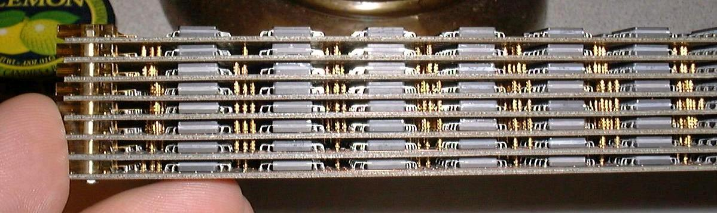
Cray-2 circuit module
Photo by Alan Kilian, former Cray employee, from personal collection of Cray components.
https://en.wikipedia.org/wiki/Cray-2#/media/File:Cray-2_module_side_view.jpg
Cooled by immersion in an inert, chilled fluid: complex, expensive
Notes:
It’s nice if your smartphone is water resistant, but think about making your computer “water-tight”!

Slide 35
Computing is change – 26 years later
Cray-2 (May 1985)
Fastest computer on the planet
Processors: 4, custom, 244 MHz clock
Main memory: 1.0 GByte
Volume: 1.5 m³ Mass: 2,500 kg
Power: 200 kilowatts (~ $500/day)
Cost: circa USD $15 million

Slide 36
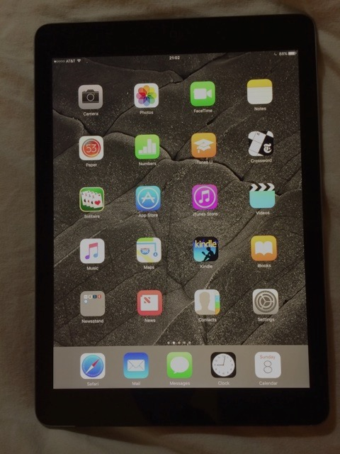
Computing is change – 26 years later
Cray-2 (May 1985)
Fastest computer on the planet
Processors: 4, custom, 244 MHz clock
Main memory: 1.0 GByte
Volume: 1.5 m³ Mass: 2,500 kg
Power: 200 kilowatts (~$500/day)
Cost: circa USD $15 million
Just as fast on a benchmark program
Processor: 2 core ARM Cortex-A9
Main memory: 0.512 GByte
Volume: 4x10⁻⁴ m³ Mass: 0.61 kg
Power: 3 Watts (< $0.01/day)
Cost: USD $499
Apple iPad 2 (March 2011)
Notes:
End of Lecture 01.

